Slide 1

Game Development Essentials An Introduction

Slide 2
Chapter 11
Production & Management
developing the process

Slide 3
Key Chapter Questions
  ■ What are the components of each phase in the game development process?
  ■ What are some effective ways to manage game development teams?
  ■ What are the different forms of documentation used in game development?

Slide 4
Development Phases
  Concept
  Pre-production
  Prototype
  Production
  Alpha
  Beta
  Gold
  Post-production

Slide 5
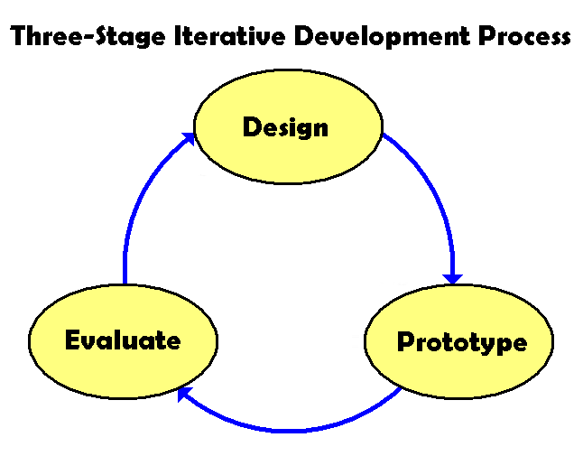
Management

Slide 6
Management
Common Mistakes
  Lack of motivation
  Lack of skill
  Difficult employees
  Restricted environment
  Insufficient tracking
  Incomplete task list
  Misunderstandings
  Unplanned tasks
  Waiting to fix bugs

Slide 7
Management
Recovery from Mistakes (Traps)
    Planning to catch up later
    Requiring mandatory overtime
    Adding people to the project
    Holding more meetings

Slide 8
Guidelines for Effective Management
      Ask for input instead of issuing orders
      Involve the team in the planning stage and be flexible with scheduled
      deadlines if necessary
      Encourage employees to discuss problems
      Don’t panic when problems arise – and don’t personalize them
      Before making decisions, get the facts and see if the team can reach
      consensus
      Make sure employees have several uninterrupted hours of work each day
      Be forthcoming with your team, and do not hide information from them
      Don’t just work regular hours when you’ve asked your team to work
      overtime
      Don’t make promises to employees in order to get them to make
      personal sacrifices for the project
      Provide significant rewards to employees after the project is completed

Slide 9
Documentation
Concept
        Premise
        Player motivation
        Unique selling
        proposition (USP)
        Market
        Genre
        Rating
        Platform
        License
        Competitive analysis
        Goals

Slide 10
Documentation
Proposal
        Hook
        Gameplay
        Online features
        Technology
        Art & audio features
        Production details
        Backstory
        Story synopsis
        Character descriptions
        Risk analysis
        Development budget
        Concept art
        Concept documentation components

Slide 11
Documentation
Game Design Document (GDD)
        Game interface
        Character abilities & items
        Game world
        Game engine
        Concept document &
        proposal components

Slide 12
Documentation
Additional Documentation
        Art bible
        Technical design document
        Project plan
        Test plan

Slide 13
Summary
  Development Phases
  Concept
  Pre-production
  Prototype
  Production
  Alpha
  Beta
  Gold
  Post-production
  Management
  Iterative
  development
  Common
  mistakes
  Recovery from
  mistakes (traps)
  Guidelines for
  effective
  management
  Documentation
  Concept
  Proposal
  Game design
  document (GDD)
  Art bible
  Technical design
  document
  Project plan
  Test plan

